Slide 1
23AD2001O
Bharath Kalyan
Nava Sruthi K
2310030049
2310030229
Rohan Koundinya
2310030010

Slide 2

23AD2001O
AIML
23AD2001O
ARTIFICIAL INTELLIGENCE AND MACHINE LEARNING
Nava Sruthi K
Rohan Koundinya
Bharath Kalyan
2310030229
2310030010
2310030049

Slide 3

23AD2001O
AI
Database Design for Analyzing 911 Call Data
ML
We will explore the critical importance of 911 call data analysis for enhancing public safety and emergency response. We'll delve into database design considerations, from understanding the data structure to implementing robust security measures.
ARTIFICIAL INTELLIGENCE AND MACHINE LEARNING

Slide 4
Database Design for Analyzing 911 Call Data
We will explore the critical importance of 911 call data analysis for enhancing public safety and emergency response. We'll delve into database design considerations, from understanding the data structure to implementing robust security measures.

Slide 5
Introduction: Importance of 911 Call Data Analysis
Insights into Trends
Improved Response Times
Data-Driven Decision-Making
Analyzing 911 calls helps identify crime hotspots, patterns of violence, and common emergency situations, providing valuable insights for prevention and resource allocation.
Optimizing response times is crucial in emergencies. Data analysis can reveal potential delays, identify bottlenecks, and optimize dispatch strategies.
Analyzing 911 calls informs public safety initiatives, resource deployment, and policy decisions, leading to better-informed and proactive responses.

Slide 6

Understanding the 911 Call Data Structure
Call Details
Dispatch Information
Call timestamp, location, caller's information, nature of emergency, and any relevant details about the incident.
Dispatcher's notes, response units assigned, time of dispatch, arrival time, and other critical response details.
Incident Data
Follow-Up Data
Details about the incident, including location, severity, type of incident (fire, medical, crime), and any related information.
Incident outcome, police reports filed, medical reports generated, and any subsequent investigations conducted.

Slide 7





Identifying Key Entities and Relationships
Call
1
The central entity, representing a single 911 call.
Caller
2
Information about the person who made the call.
Location
3
Coordinates of the emergency location.
Incident
4
Details about the emergency situation.
Response Unit
5
Information about the emergency response team.

Slide 8




Normalizing the Database Schema
Eliminate Data Redundancy
Improve Data Consistency
Enhance Data Security
Reduce data duplication and ensure data integrity by breaking down data into smaller tables.
Maintain consistency across the database by ensuring that each piece of information is stored only once.
Protect sensitive data by storing it separately in normalized tables, reducing the risk of unauthorized access.

Slide 9
Dimensional Modeling for Data Warehousing
Fact Table
1
Central table containing core measures, such as call volume, response time, and incident outcomes.
Dimension Tables
2
Contain descriptive information about the measures in the fact table, such as caller details, incident type, and response unit information.
Star Schema
3
A simplified data model where the fact table is at the center and dimension tables radiate outward.
Snowflake Schema
4
A more complex model that allows for hierarchical dimension tables, providing more granular analysis.

Slide 10

Optimizing Data Storage and Retrieval
Implement caching mechanisms to store frequently accessed data in memory, reducing the need for disk access and improving response times.
Choose an appropriate database management system (DBMS) that can efficiently handle large datasets and complex queries.
1
2
3
Use indexing and partitioning techniques to speed up query execution by organizing and accessing data more efficiently.

Slide 11




Implementing Data Quality Checks and Validations
Define data validation rules to ensure data accuracy and consistency, catching errors before they enter the database.
Regularly monitor data quality metrics to identify potential data anomalies and inconsistencies that require further investigation.
Establish data cleansing processes to correct errors, missing values, and inconsistencies to maintain data integrity.

Slide 12
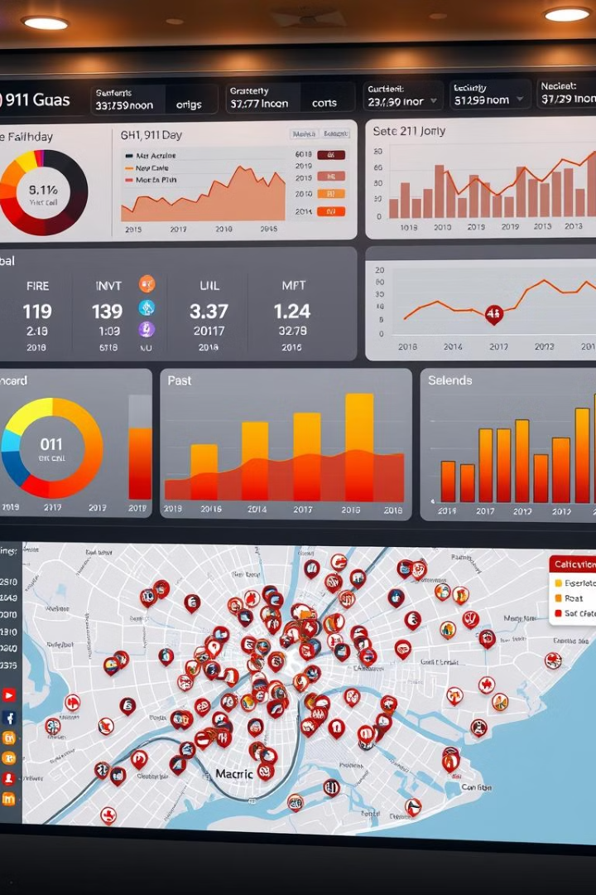
Reporting and Dashboarding Requirements
100
Key Metrics
Track call volume, response times, incident types, and other critical performance indicators.
50
Trend Analysis
Identify patterns and trends in call data to anticipate future demands and optimize emergency response.
20
Visualizations
Use dashboards and reports to present data insights in a clear and compelling way.

Slide 13




Securing and Managing the Database System
Data security is paramount in handling sensitive information. Implement robust access controls, encryption protocols, and regular security audits. Ensure data backups and disaster recovery plans are in place to prevent data loss and ensure system resilience.

Slide 14
Thank you

